Slide 1
ECODESIGN DIRECTIVE Lots1 & 2
Heaters/Water-heaters
Where are we? (March 2013)
Prepared by Jean Schweitzer DGC
Daniel HEC MARCOGAZ

Slide 2
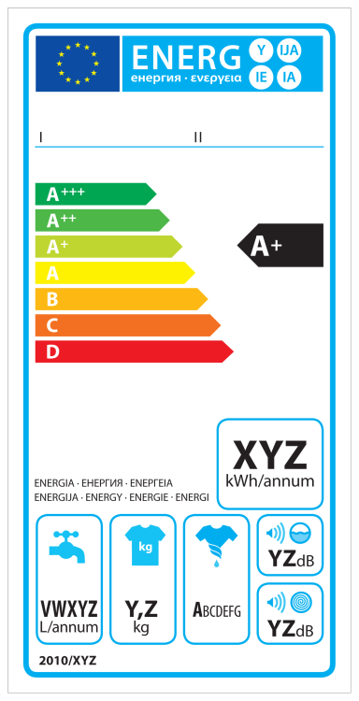
Context of the proposal
To minimize the impact of heaters/water heaters on energy consumption & emissions in the EU
Directive 2009/125/EC Ecodesign
= minimum requirements on Efficiency, NOx etc.
Directive 2010/30/EU Labelling
= indication by labelling of energy consumption

Slide 3
General context
Heating in Europe 12000 PJ (2005) = 16% of gross energy in EU-27 = annual consumption of France
Scope
  Efficiency
  Emissions
  NOx, CO, unburned hydrocarbons; noise
Expectation
  Consumption after 15 years reduced by ca 25%
For the next revision (< 5 years)

Slide 4







Process / consultations
2006
2008
2009
2010
2011
2012
2013
Preparatory. Studies
Consultation Stakeholders + Written consultations
Ad’hoc Expert Group
Regulatory Committee Ecodesign & Delegated Acts for Labelling
Consultant
(KEMNA)
Stakeholders
EHI, Marcogaz
etc
Adhoc Expert
Group (incl.
Marcogaz)
Member States

Slide 5
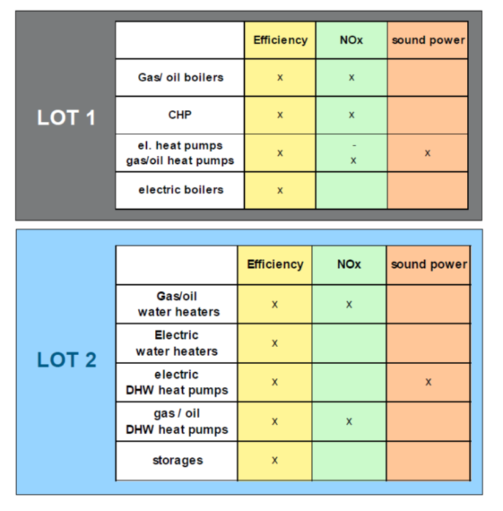
SCOPE & REQUIREMENTS
Appliances parameters subject to
minimum requirements
Requirements in two steps with more stringent requirements
Minimum Efficiency
AFTER 2 YEARS (all appliances)
AFTER 4 YEARS (mCHP, GHP etc.)
NOX
AFTER 3 YEARS (boilers)
AFTER 5 YEARS
(mCHP & GHP)

Slide 6
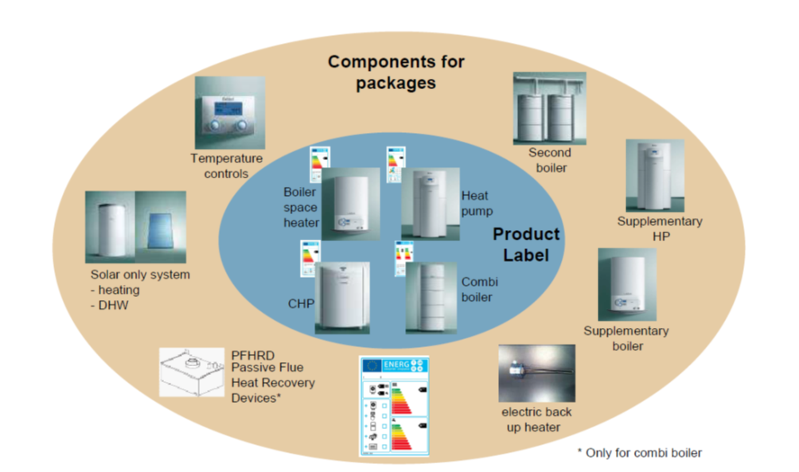
Label: Appliances and Systems
The labeling system divided in two parts: appliance label and system label
Combinations possible with solar energy or other appliances
The manufacturer is responsible for the first label (appliance), while the dealer is responsible for the second label (system).

Slide 7
Overall impact on the market for gas appliances
Philosophy:
1) Best condensing appliances can only reach A on a G to A+++ scale/range.
2) A++ and higher are reserved to renewables
Gas boilers meeting the efficiency requirements will be labeled “B” and “A”
Traditional boilers can no longer be sold (except for some specific replacements)
Severe NOx limits will apply 3 years after implementation (challenging for several products currently on the market).
Gas boilers combined with thermal solar energy can achieve an A+ label (for the package boiler + solar device, not for the boiler as stand-alone)
Gas heat pumps should be able to achieve A++ or even A+++ (not from start). Engine based compression heat pumps may have difficulties to meet the NOx limit without the use of a catalyst. El ectrical heat pumps will reach the same labels.
Micro CHP with Stirling engines will only achieve an A+ label. Same should apply to fuel cells

Slide 8
Results achieved by MARCOGAZ & GERG horizontal expert group
MARCOGAZ produced 4 public position papers during the last 3 years (more before). GERG brought some support.
Positions papers had a significant influence
Positive results:
Integration of new technolgies (mCHP & GHP) in the scope of the Directive (can competewith EHP in the categories A+, A++, A+++). (Main EU Manufacturers and EHI were against)
Lower NOx for mCHP & GHP
Energy efficiency on primary energy (2.5 coefficient) : this allow a fair competition between energies. We tried to propose a value > 2.5 but did not succeed.
Third party testing for gas appliances
Points for which we couldn’t succeed:
mCHP limited to A+
Third part testing for non-gas appliances

Slide 9
APPLIANCE Label
6 years
  1.1.2020?
Heat pumps
Cogeneration
CH boilers
  2 years
  1.1.2016?
CH boiler label from green
to yellow
E F G
+ F & G
review five years after the entry in force

Slide 10
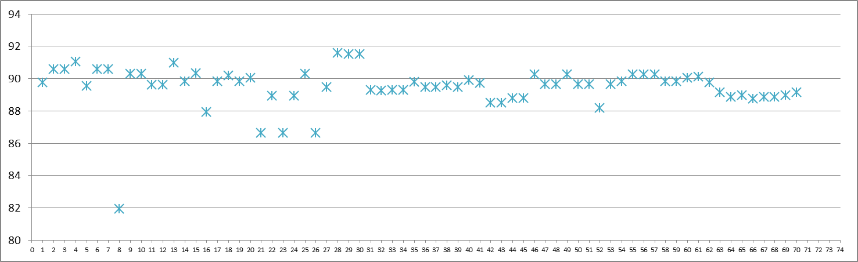
Label on actual condensing boilers on DK market
Label
A
B
C
Minimum requirement for efficiency
(no actual DK boiler banned)

Slide 11
Minimum Seasonal space heating energy efficiency
Appliance | AFTER 2 YEARS | AFTER 4 YEARS
Fuel boilers ≤ 70 kW | 86 % | unchanged
Fuel boilers > 70 kW and ≤ 400 kW | Full load 86 % Part load 94 % | unchanged
Type B11 boilers | 75 % | unchanged
Cogeneration space heaters | 86 % | 100 %
Heat pumps | 100 %. | 110 %
Low-temperature heat pumps | 115 % | 125 %

Slide 12
Max NOx emissions
(all given on GCV*)
Appliance | AFTER 3 YEARS | AFTER 5 YEARS
Gas boilers | 70 mg/kWh | unchanged
Fuel oil boilers | 120 mg/kWh | unchanged
Cogeneration space heaters or Heat pumps with external combustion using gaseous fuels | None | 70 mg/kWh
Cogeneration space heaters or Heat pumps with external combustion using liquid fuels | None | 120 mg/kWh
Cogeneration space heaters or Heat pumps with internal combustion using gaseous fuels | None | 240 mg/kWh
Cogeneration space heaters or Heat pumps with internal combustion using liquid fuels | None | 420 mg/kWh
* Gross calorific value

